Slide 1

INTERRUPT
- Aakash Dhakal

Slide 2
INTRODUCTION
Interrupt is a method of halting the currently executing program by peripheral devices or instructions in order to “service” themselves
ISR (Interrupt Service Routine), which is a short program, handles the interrupts. Each interrupt will most probably have its own ISR.
After ISR completes the requires task then the microprocessor continues to execute the program which was previously halted

Slide 3
Interrupt in 8085 Microprocessor
When request signal is received microprocessor will halt the current execution and control is transferred to sub routine (ISR) by generating CALL signal
After competing subroutine program control is transferred back to the main program by generating RET signal
Microprocessor sends an acknowledgement (INTA) to the device that is requesting interrupt signal

Slide 4
Interrupt
Main Routine
INTA
Save Program Counter
Send Interrupt Acknowledgement
Get original program Counter
ISR
Fig: Interrupt in 8085

Slide 5
Classification of Interrupt
Interrupt
Hardware
Software
Unmaskable
Maskable

Slide 6
Hardware & Software Interrupt
When microprocessors receive interrupt signals through pins (hardware) of microprocessor, they are known as Hardware Interrupts. There are 5 Hardware Interrupts in 8085 microprocessor. They are – INTR, RST 7.5, RST 6.5, RST 5.5, TRAP.
Software Interrupts are those which are inserted in between the program which means these are mnemonics of microprocessor. There are 8 software interrupts in 8085 microprocessor. They are- RST0, RST1, RST2, RST3, RST4, RST5, RST6, RST7.

Slide 7
Maskable & Non-Maskable Interrupts
Maskable Interrupts are those which can be disabled or ignored by the microprocessor. These interrupts are either edge-triggered or level-triggered, so they can be disabled. INTR, RST 7.5, RST 6.5, RST 5.5 are maskable interrupts in 8085 microprocessor.
Non-Maskable Interrupts are those which cannot be disabled or ignored by microprocessor. TRAP is a non-maskable interrupt. It consists of both level as well as edge triggering and is used in critical power failure conditions.

Slide 8
Vectored & Non-Vectored Interrupts
Vectored Interrupts are those which have fixed vector address (starting address of sub-routine) and after executing these, program control is transferred to that address.
Non-Vectored Interrupts are those in which vector address is not predefined. The interrupting device gives the address of sub-routine for these interrupts. INTR is the only non-vectored interrupt in 8085 microprocessor.

Slide 9
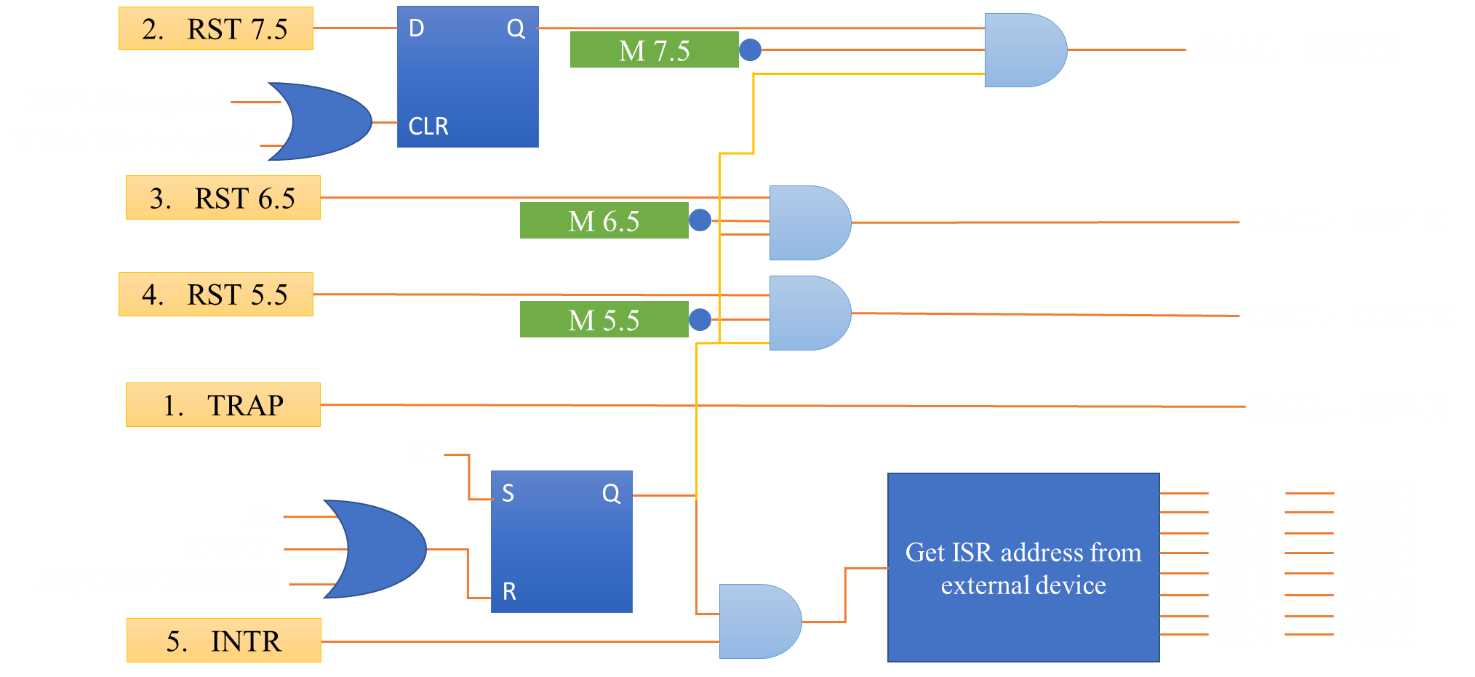
Fig: Interrupt Structure in 8085

Slide 10
Application of Interrupts
A disk interrupt signals the completion of a data transfer from or to the disk peripheral; this may cause a process to run which is waiting to read or write.
A power-off interrupt predicts imminent loss of power, allowing the computer to perform an orderly shut-down while there still remains enough power to do so.
Keyboard interrupts typically cause keystrokes to be buffered so as to implement typeahead.

Slide 11
REFERENCES
INTERRUPT IN THE 8085 MICRO-PROCESSOR: | by Utsa Ghosh | Medium
Interrupts in 8085 Microprocessor - Easy Electronics
Interrupts in 8085 microprocessor – GeeksforGeeks
Interrupts in 8085 | Microprocessors Tutorials | Teachics
8085 Addressing Modes & Interrupts (tutorialspoint.com)

Slide 12
Thank You

